Slide 1
Connection to the Linux KVM (Kernel-based Virtual Machine)
CSC 4760 / 6760 Big Data Programming
Spring 2020

Slide 2
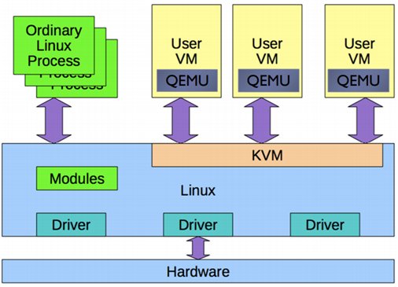
KVMs on Jaguar Server
Jaguar Server
IP: 131.96.155.248
jaguar.cs.gsu.edu
40 CPU cores, 128 GB ram
40 TB disk
KVMs (virt-manager)
50 KVMs (one for each student)
1 CPU core, 2 GB memory
20 GB disk
buyvm.net
1 CPU core, 2 GB memory
$2 / month

Slide 3
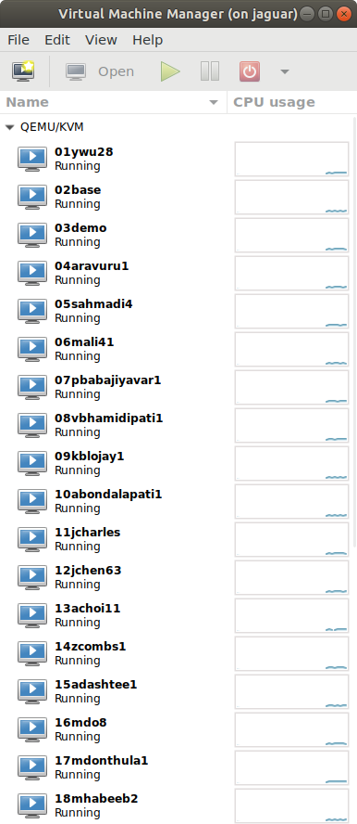
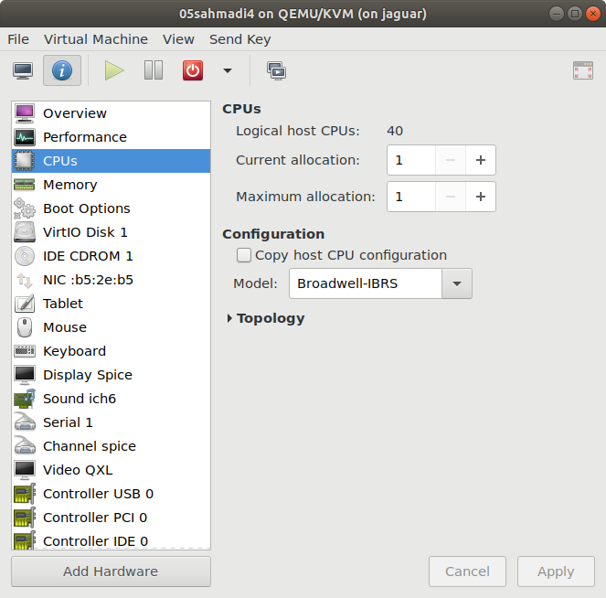
KVMs on Jaguar

Slide 4
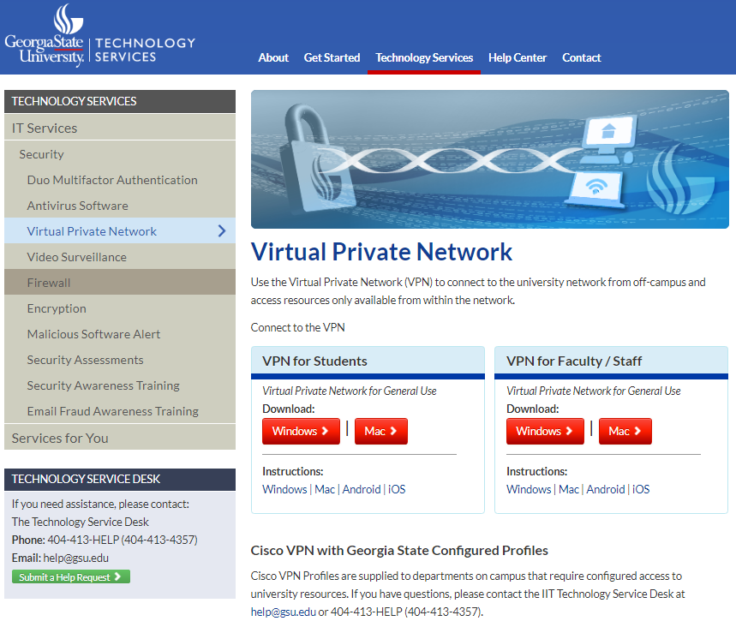
Connect to GSU VPN (Virtual Private Network)
We put Jaguar’s KVMs behind the GSU Firewall, so it is impossible to SSH in from the public internet. We have to connect to the GSU network through its VPN.
Google “GSU VPN”, the first non-ads link:
Virtual Private Network - GSU Technology
Tutorials for Windows and Mac
https://technology.gsu.edu/technology-services/it-services/security/virtual-private-network/

Slide 5
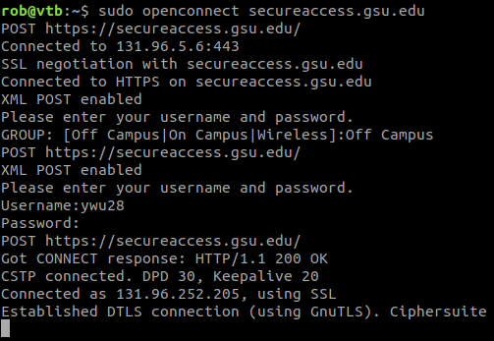
Connect to GSU VPN in Ubuntu OS:
Step 1: Install OpenConnect
$ sudo apt-get update
$ sudo apt-get install openconnect
Step 2: Connect to the GSU VPN Server
$ sudo openconnect secureaccess.gsu.edu
GSU does not provide an instruction on how to use VPN service from Linux. But an online tutorial is available:
https://flaviutamas.com/2018/connecting-gsu-hpc

Slide 6
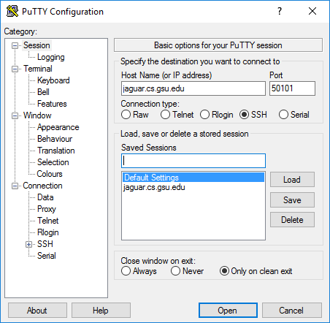
Connect to KVM via PuTTY (https://www.putty.org/)
PuTTY: a free SSH and Telnet client
Host: jaguar.cs.gsu.edu or 131.96.155.248
Port: each student has a port number
e.g., ywu28 : 50101 (no 22, 22 is for jaguar host)
Click on Open button
Input your user name (campus ID) and your password:

Slide 7
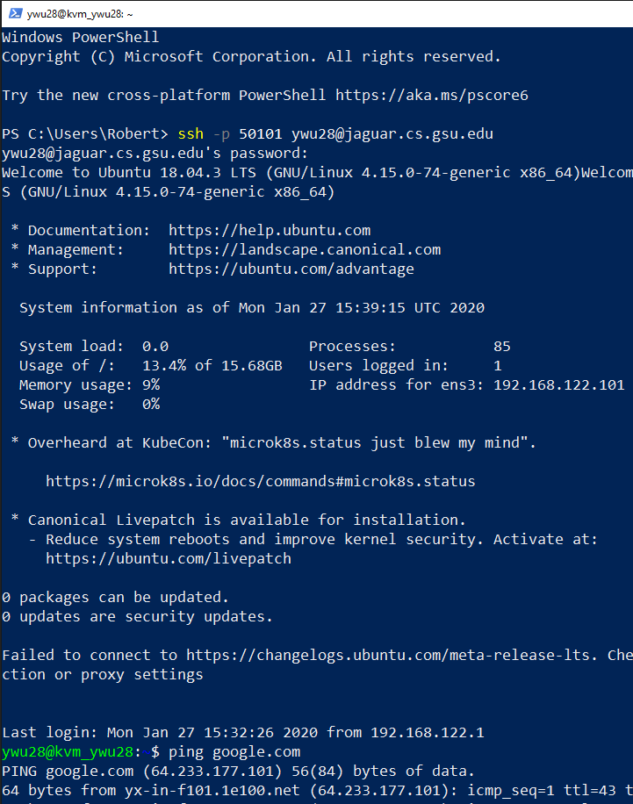
Connect to KVM via Windows PowerShell
Host: jaguar.cs.gsu.edu or 131.96.155.248
Port: each student has a port number
e.g., ywu28 : 50101 (no 22, 22 is for jaguar host)
> ssh -p 50101 YourCampusID@jaguar.cs.gsu.edu
Input your password:

Slide 8
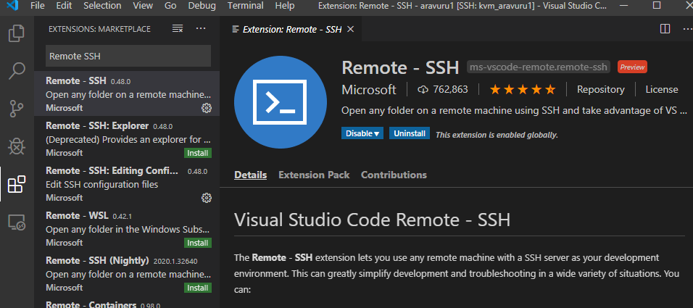
Connect to KVM via Visual Studio Code IDE
Install Visual Studio Code
Extensions => Remote SSH => Install

Slide 9
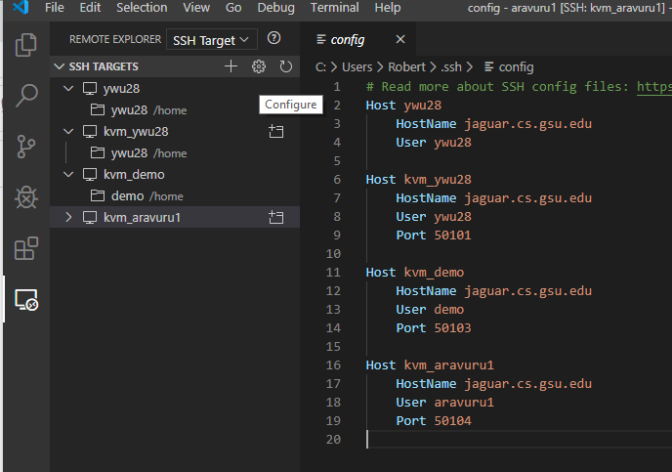
Connect to KVM via Visual Studio Code IDE
Remote Explorer => Configure => C:\Users\...\.\ssh\config
Example for one connection:
Host kvm_ywu28
HostName jaguar.cs.gsu.edu
User ywu28
Port 50101

Slide 10
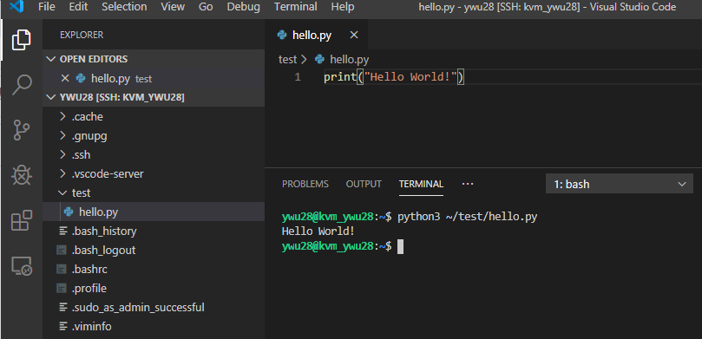
Connect to KVM via Visual Studio Code IDE
Create an “Hello World” example: hello.py
In “Terminal”, run
$ python3 ~/test/hello.py
It is working!

Slide 11
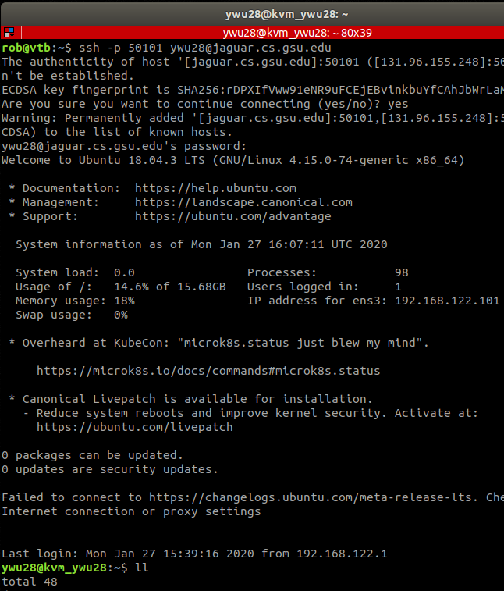
Connect to KVM in Ubuntu
In “Terminal”, run
$ ssh -p 50101 ywu28@jaguar.cs.gsu.edu
Sometime we need to force it using passwd:
$ ssh -o PreferredAuthentications=password -o PubkeyAuthentication=no -p 50101 ywu28@jaguar.cs.gsu.edu

Slide 12
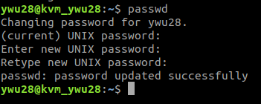
Change your password in KVM
After you login to the KVM, open the “Terminal”, run
$ passwd
Input current password
Enter new password
Retype new password

Slide 13
Port Assignment
Last Name | First Name | Campus ID | Port
Ahmadi | Siavash | sahmadi4 | 50105
Ali | Mohamed | mali41 | 50106
Babajiyavar | Pavan | pbabajiyavar1 | 50107
Bhamidipati | Veera Venkata Subramanya Aditya | vbhamidipati1 | 50108
Blojay | Kelvin | kblojay1 | 50109
Bondalapati | Avinash | abondalapati1 | 50110
Charles | Jhante | jcharles | 50111
Chen | Jun | jchen63 | 50112
Choi | Amber | achoi11 | 50113
Combs | Zachary | zcombs1 | 50114
Dashtee | Abbas | adashtee1 | 50115

Slide 14
Port Assignment
Last Name | First Name | Campus ID | Port
Do | Mimi | mdo8 | 50116
Donthula | Mithilesh | mdonthula1 | 50117
Habeeb | Shoeb | mhabeeb2 | 50118
Herrera | Jason | jherrera6 | 50119
Hoff | Charles | choff3 | 50120
Horning | Kevin | khorning2 | 50121
Hossaini | Sayed | shossaini1 | 50122
Jones | T'Avvion | tjones172 | 50123
Kalipindi | Purna Sai Pushkal | pkalipindi1 | 50124
Kambhampati | Sravya | lkambhampati1 | 50125
Kanchala | Pravalika | pkanchala1 | 50126

Slide 15
Port Assignment
Last Name | First Name | Campus ID | Port
Katragadda | Krishna Mani Teja | kkatragadda1 | 50127
Khan | Hiba | hkhan14 | 50128
Khan | Rabia | rkhan19 | 50129
Kunta | Harish | hkunta1 | 50130
Lewis | Timothy | tlewis58 | 50131
Malapati | Venkata Bharath | vmalapati1 | 50132
Nocero | Austin | anocero1 | 50133
Noor | Nadiya | nnoor3 | 50134
Palisetty | Anusha | apalisetty1 | 50135
Parajuli | Aditya | aparajuli1 | 50136
Pinder | Jonathan | jpinder1 | 50137
Qiao | Linran | lqiao2 | 50138

Slide 16
Port Assignment
Last Name | First Name | Campus ID | Port
Quezada | Jorge | jquezada4 | 50139
Rasuli | Viktoriya | vrasuli1 | 50140
Rutkowski | Kamil | krutkowski1 | 50141
Sethi | Avneet | asethi2 | 50142
Turupu | Sameera | sturupu1 | 50143
Vang | Dustin | dvang1 | 50144
Wang | Jingjing | jwang69 | 50145
Wang | Tianchun | twang22 | 50146
Wang | Xiao | xwang62 | 50147
Williams | Jonathan | jwilliams495 | 50148
Wilson | Savada | swilson134 | 50149
Zhao | Yue | yzhao23 | 50150

Slide 17
Notes
The KVM is only for CSC 4760/6760 Big Data Programming class. It is for testing Hadoop, Spark, and related software. It has limited resources.
You have the sudo right, but please do not change your IP address, or networking settings. No need to setup a firewall.
Please DO NOT use the KVM in a malicious way such as
Downloading a digital product with copyright (such as movie or ebook) using a torrent app
Mining bitcoin
Launching a cyber attack
……

